Slide 1
Introduction Objective programming (C #) - design patterns

Slide 2
Azure application architecture fundamentals

Slide 3
Introduction
The cloud is changing how applications are designed and secured. Instead of monoliths, applications are decomposed into smaller, decentralized services.
These services communicate through APIs or by using asynchronous messaging or eventing. Applications scale horizontally, adding new instances as demand requires.

Slide 4
These trends bring new challenges. Application states are distributed. Operations are done in parallel and asynchronously.
Applications must be resilient when failures occur. Malicious actors continuously target applications. Deployments must be automated and predictable.
Monitoring and telemetry are critical for gaining insight into the system.

Slide 5
Traditional on-premises | Modern cloud
Monolithic Designed for predictable scalability Relational database Synchronized processing Design to avoid failures (MTBF) Occasional large updates Manual management | Decomposed Designed for elastic scale Polyglot persistence (mix of storage technologies) Asynchronous processing Frequent small updates Automated self-management Immutable infrastructure

Slide 6
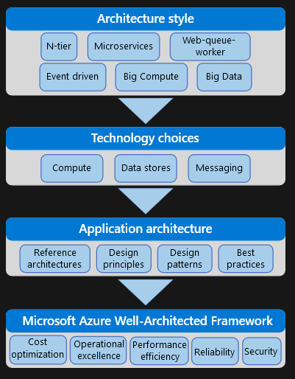
How this guidance is structured
The Azure application architecture fundamentals guidance is organized as a series of steps, from the architecture and design to implementation. For each step, there is supporting guidance that will help you design your application architecture.

Slide 7
Architecture styles
The first decision point is the most fundamental. What kind of architecture are you building? It might be a microservices architecture, a more traditional N-tier application, or a big data solution.
We have identified several distinct architectural styles. There are benefits and challenges to each.

Slide 8
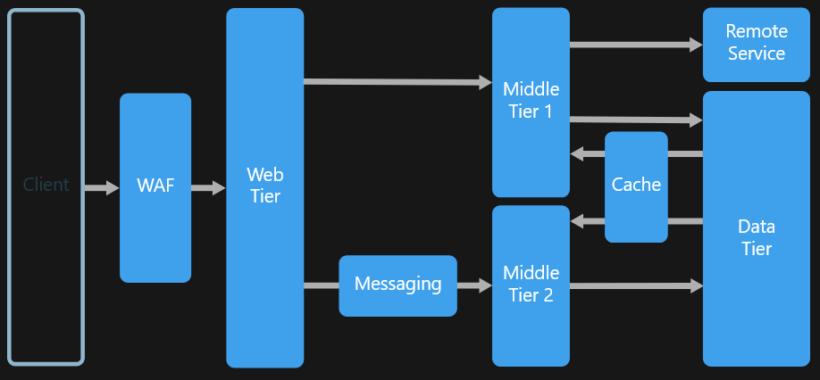
A quick tour of the styles
N-tier

Slide 9
N-tier is a traditional architecture for enterprise applications. Dependencies are managed by dividing the application into layers that perform logical functions, such as presentation, business logic, and data access.
A layer can only call into layers that sit below it. However, this horizontal layering can be a liability.
It can be hard to introduce changes in one part of the application without touching the rest of the application. That makes frequent updates a challenge, limiting how quickly new features can be added.

Slide 10
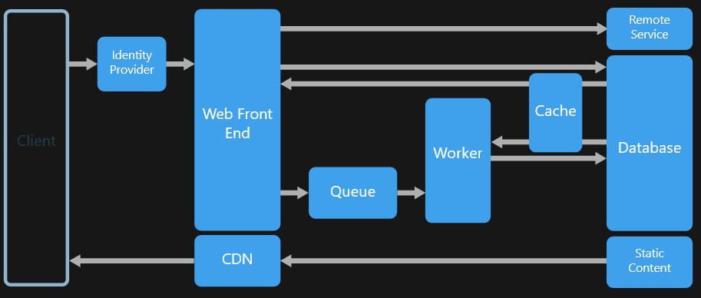
Web-Queue-Worker

Slide 11
For a purely PaaS solution, consider a Web-Queue-Worker architecture. In this style, the application has a web front end that handles HTTP requests and a back-end worker that performs CPU-intensive tasks or long-running operations.
The front end communicates to the worker through an asynchronous message queue.
Web-queue-worker is suitable for relatively simple domains with some resource-intensive tasks. Like N-tier, the architecture is easy to understand..

Slide 12
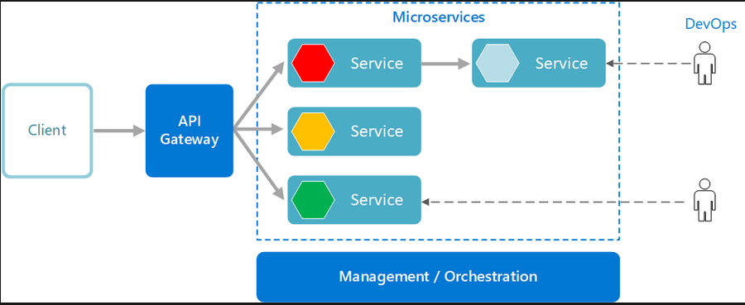
Microservices

Slide 13
If your application has a more complex domain, consider moving to a Microservices architecture. A microservices application is composed of many small, independent services.
Each service implements a single business capability. Services are loosely coupled, communicating through API contracts.
Each service can be built by a small, focused development team. Individual services can be deployed without a lot of coordination between teams, which encourages frequent updates.

Slide 14
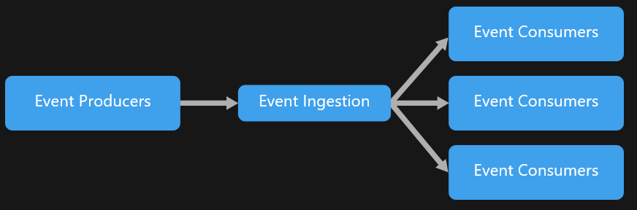
Event-driven architecture

Slide 15
Event-Driven Architectures use a publish-subscribe (pub-sub) model, where producers publish events, and consumers subscribe to them. The producers are independent from the consumers, and consumers are independent from each other.
Consider an event-driven architecture for applications that ingest and process a large volume of data with very low latency, such as IoT solutions.
The style is also useful when different subsystems must perform different types of processing on the same event data.

Slide 16
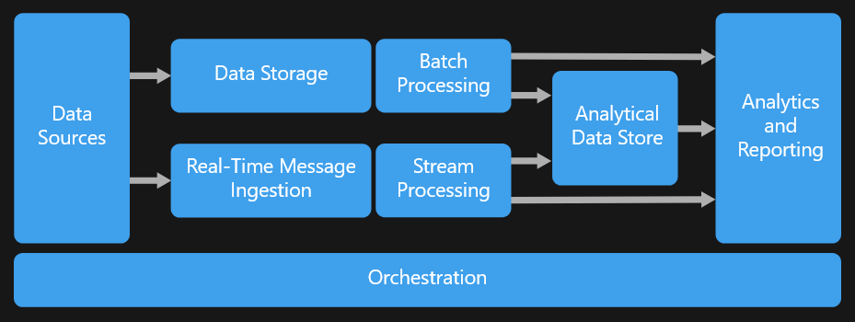
Big Data, Big Compute

Slide 17
Big Data and Big Compute are specialized architecture styles for workloads that fit certain specific profiles.
Big data divides a very large dataset into chunks, performing parallel processing across the entire set, for analysis and reporting.
Big compute, also called high-performance computing (HPC), makes parallel computations across a large number (thousands) of cores. Domains include simulations, modeling, and 3-D rendering.

Slide 18
Architecture styles as constraints
An architecture style places constraints on the design, including the set of elements that can appear and the allowed relationships between those elements.
Constraints guide the "shape" of an architecture by restricting the universe of choices. When an architecture conforms to the constraints of a particular style, certain desirable properties emerge.

Slide 19
For example, the constraints in microservices include:
A service represents a single responsibility.
Every service is independent of the others.
Data is private to the service that owns it. Services do not share data.
By adhering to these constraints, what emerges is a system where services can be deployed independently, faults are isolated, frequent updates are possible, and it's easy to introduce new technologies into the application.

Slide 20
Technology choices
Knowing the type of architecture you are building, now you can start to choose the main technology pieces for the architecture. The following technology choices are critical:
Compute refers to the hosting model for the computing resources that your applications run on.
Data stores include databases but also storage for message queues, caches, logs, and anything else that an application might persist to storage.
Messaging technologies enable asynchronous messages between components of the system

Slide 21
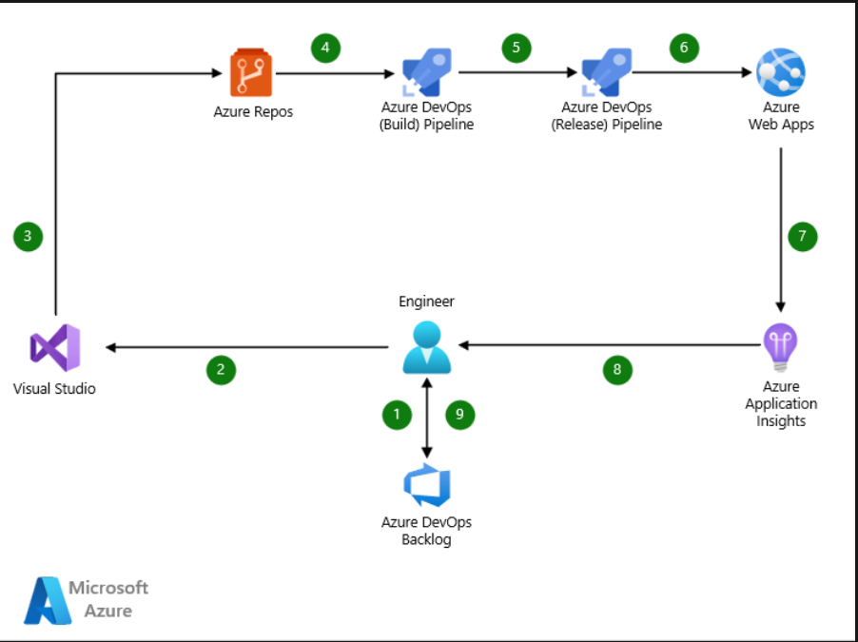
CI/CD for Azure Web Apps
Azure Web Apps is a fast and simple way to create web apps using ASP.NET, Java, Node.js, Python, and other languages and frameworks.

Slide 22
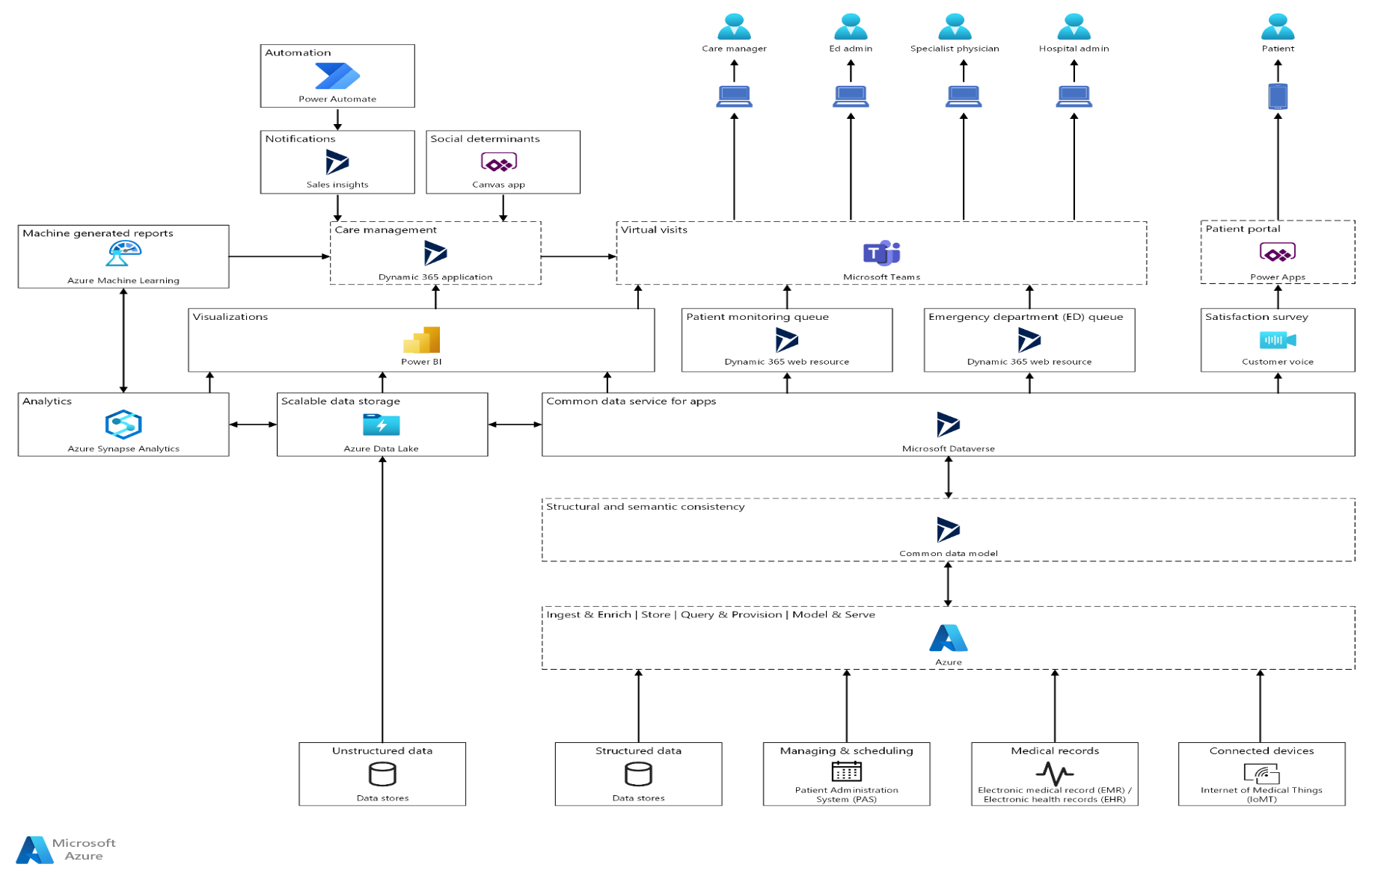
Clinical insights with Microsoft Cloud for Healthcare
By using Microsoft Cloud for Healthcare, you can build solutions to improve clinical and operational insights.

Slide 23
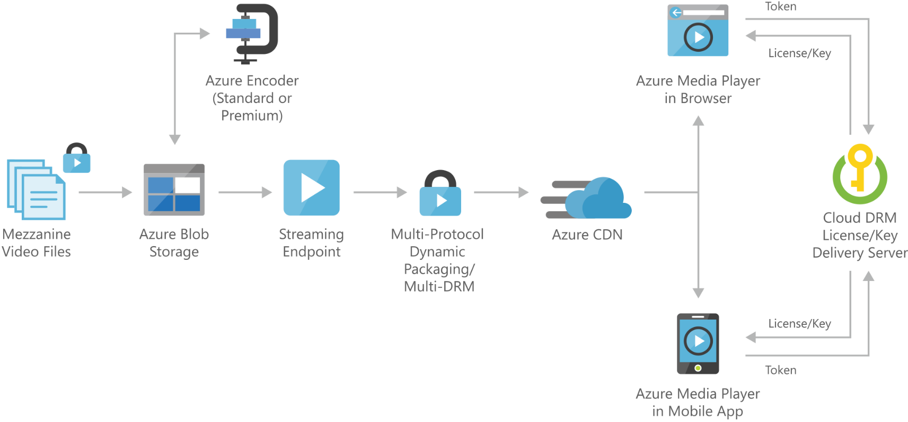
Video-on-demand digital media
This solution is built on the Azure managed services: Blob Storage, Content Delivery Network, and Azure Media Player from Azure Media Services. These services run in a high-availability environment, patched and supported, allowing you to focus on your solution instead of the environment they run in.

Slide 24
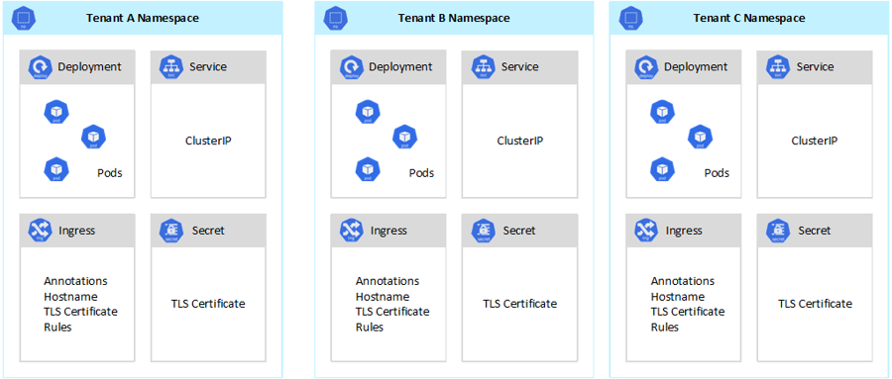
Azure Kubernetes Service (AKS) considerations for multitenancy
Azure Kubernetes Service (AKS) simplifies deploying a managed Kubernetes cluster in Azure by offloading the operational overhead to the Azure cloud platform. As a hosted Kubernetes service, Azure handles critical tasks, like health monitoring and maintenance.

Slide 25
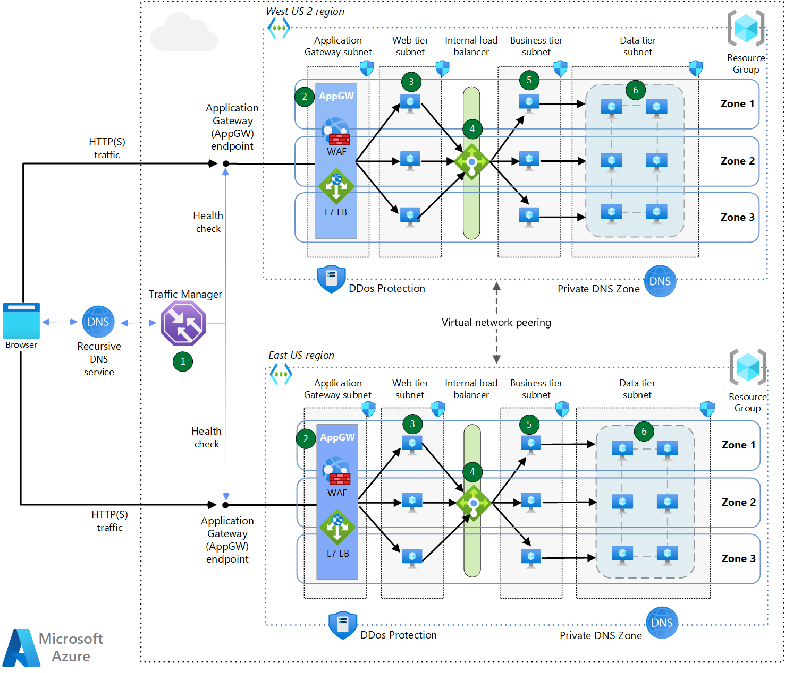
Multi-region load balancing with Traffic Manager and Application Gateway
This architecture is for global, internet-facing applications that use HTTP(S) and TCP protocols. It features DNS-based global load balancing, two forms of regional load balancing, and global virtual network peering to create a high availability architecture that can withstand a regional outage.

Slide 26
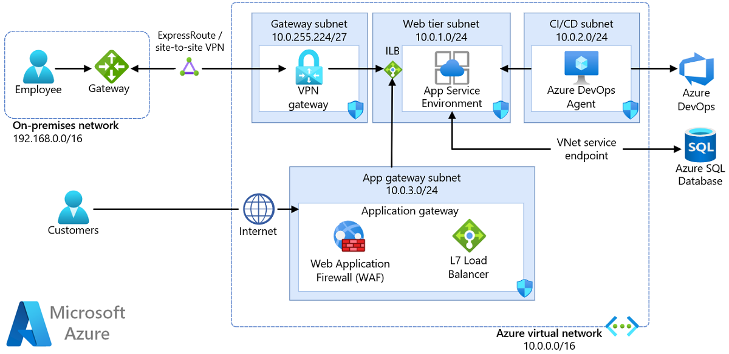
Securely managed web applications
This article provides an overview of deploying secure applications using the Azure App Service Environment. To restrict application access from the internet, the Azure Application Gateway service and Azure Web Application Firewall are used.

Slide 27
Introduction to messaging patterns

Slide 28
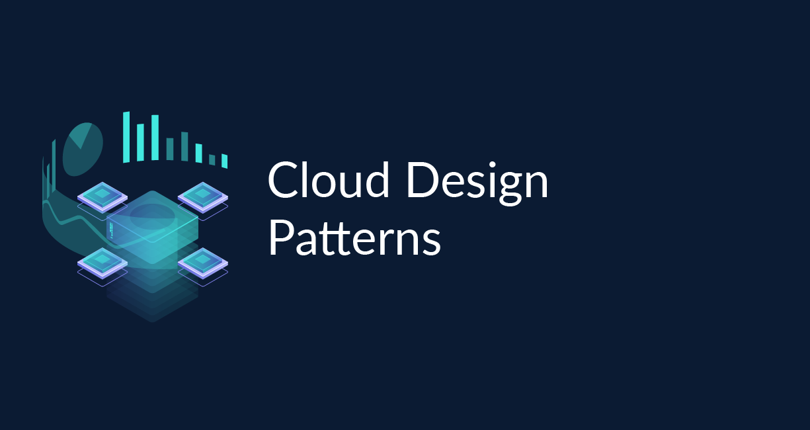
Introduction to messaging patterns
The distributed nature of cloud applications requires a messaging infrastructure that connects the components and services, ideally in a loosely coupled manner in order to maximize scalability.
Asynchronous messaging is widely used, and provides many benefits, but also brings challenges such as the ordering of messages, poison message management, idempotency, and more.

Slide 29
Introduction to messaging patterns
Pipes and Filters
Priority Queue
Publisher-Subscriber
Queue-Based Load Levelling

Slide 30
Introduction to Data management patterns

Slide 31
Data management patterns
Data management is the key element of cloud applications, and influences most of the quality attributes.
Data is typically hosted in different locations and across multiple servers for reasons such as performance, scalability or availability, and this can present a range of challenges. For example, data consistency must be maintained, and data will typically need to be synchronized across different locations.

Slide 32
Data management patterns
Cache-Aside
Event Sourcing
Static Content
Sharding

Slide 33
Introduction to Design and implementation patterns

Slide 34
Design and implementation patterns
Good design encompasses factors such as consistency and coherence in component design and deployment, maintainability to simplify administration and development, and reusability to allow components and subsystems to be used in other applications and in other scenarios.
Decisions made during the design and implementation phase have a huge impact on the quality and the total cost of ownership of cloud hosted applications and services.

Slide 35
Design and implementation patterns
Pattern Summary
Asynchronous Request-Reply
Claim Check
Choreography
Competing Consumers
Gateway Aggregation
Gateway Offloading

Slide 36
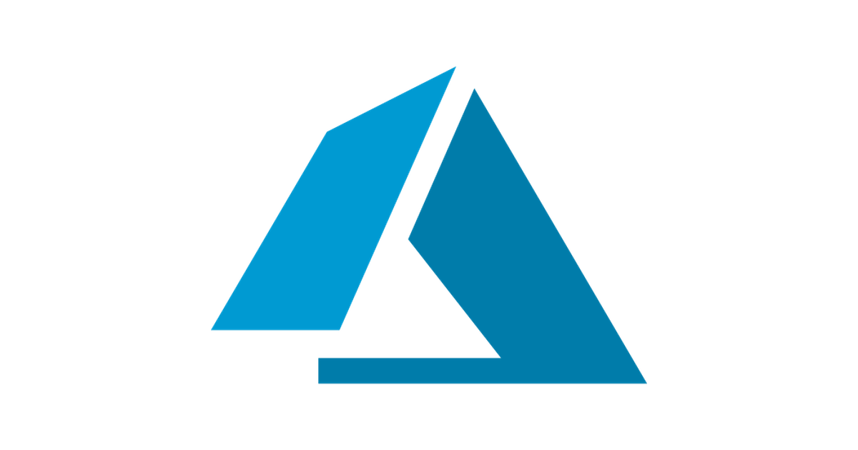

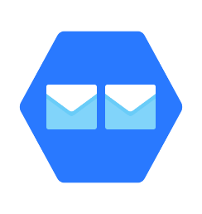


Azure Messaging Services
Service Bus
Event Grid
Event Hub
Storage Queue
P2P messaging
Pub-Sub messaging
Cost efficient
Durable brokered messaging
Ent. messaging functionality
Sessions
Duplicate Detection
Message Expiration
Scheduled Expiration
HTTP-based event delivery
Supported by many azure services
Near real-time notifications
First 100.000 operations are free
Simple (Few clicks to build real data pipelines)
Secure (Certified by CSA STAR, ISO, PCI, HIPAA, HITRUST, GxP)
Massively scalable
Open (Support popular protocols, AMQP, HTTPS, Apache Kafka.)
Basic P2P Communication
Cost Effective (pay only for what we use)
Compliance certifications (ISO, ITAR, CSA, CDSA)

Slide 37





Messaging in real life
Healthcare
Financial
Logistics
Telecommunications
Public Sector

Slide 38



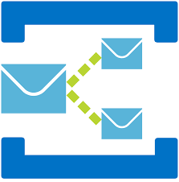
Azure Service Bus
Azure Service Bus (Messaging as a Service - MaaS) is an asynchronous cloud delivery messaging service,
and offers a secure data transfer between different applications.
Namespace
Protocols
Queues
HTTP-HTTPS
Topics
AMQP
SBMP
Service Bus Messaging Protocol
Default protocol used by Service Bus SDK
Supported by many apps
Open messaging protocol
Ports 5671 & 5672
Default protocol used by Service Bus SDK
Supported by many apps
Open messaging protocol
Ports 930 & 9354
Cross platform compatibility with many clients
Provide communication where firewalls may limit connectivity on other protocols.
Ports 80 & 443
Many Front End applications send messages to the queue and one application on the back end serves those requests in order of priority,
This is a publish-subscribe model, push the message into a topic and that message sent to all subscribers one to many, e.g Twitter or Facebook feeds.

Slide 39
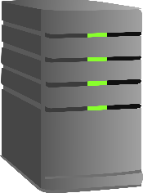
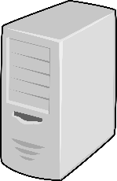
Enterprise Service Bus
“An enterprise service bus (ESB) implements a communication system between mutually interacting software applications in a service-oriented architecture (SOA). It represents a software architecture for distributed computing, and is a special variant of the more general client-server model, wherein any application may behave as server or client.”
Source: wikipedia
Enterprise Service Bus (ESB)

Slide 40

Azure Service Bus Queue
Message Sender
Service Bus
Namespace
Message Receiver
Web App
Service or App
Queue
Mobile App
Service App
P2P messaging
First In, First Out (FIFO) processing

Slide 41
Azure Service Bus Topics & Subscriptions
Message Sender
Service Bus
Namespace
Message Receiver
Web App
Subscription01
Service or App 01
Mobile App
Topic
Subscription02
Service or App 02
Service App
Subscription03
Service or App 03
Pub – Sub messaging
Messages are sent to Topics and received from Subscriptions

Slide 42
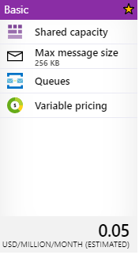
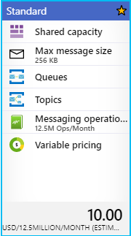
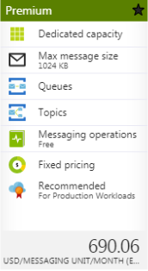
Azure Service Bus Pricing Tiers

Slide 43
Azure Service Bus Features Per Tier
Feature | BASIC TIER | STANDARD TIER | PREMIUM TIER
Queues | Available | Available | Available
Scheduled messages | Available | Available | Available
Topics | Not available | Available | Available
Transactions | Not available | Available | Available
De-duplication | Not available | Available | Available
Sessions | Not available | Available | Available
Forward TO / Send Via | Not available | Available | Available
Message size | 256 KB | 256 KB | 1 MB
Brokered connections included | 100 | 10,001 | 1,000 per MU
Brokered connections (overage allowed) | Not available | Billable | Up to 1,000 per MU
Resource isolation | Not available |  | Available
Geo-disaster recovery (Geo-DR) | Not available |  | Available (Requires additional Service Bus Premium namespaces in another region)

Slide 44
Azure Service Bus Advanced Features
Feature | Description
Message sessions | Sessions are grouped related messages and processed together, also sessions can guarantee FIFO sorting
Duplicate detection | Duplicate messages can be ignored by a messaging entity
Message deferral | Messages can be preserved on a messaging entity and retrieved later for processing
Dead-lettering | Invalid or poison messages can be moved to a dead-letter queue
Message expiration | Messages can be configured to expire after a specified duration
Batching | Messages can be sent in a single batch, during a period of time delay on a queue or a topic
Scheduled delivery | Messages can be start processing at a certain time after a delay.
Auto-forwarding | Automatically removes a queue or subscription to another queue or topic in the same namespace.
Filtering and actions | The subscriber can filter which message want to receive from the topic.

Slide 45




Service Bus Tools
Azure Portal
Visual Studio
Visual Studio Code
Service Bus Explorer

Slide 46

Topics & Subscriptions
Sender only knows about Topic
Receivers only know about Subscriptions
Filters and Actions exist on Subscriptions
type=order
Filter
Subscription 1
“type” = “order”
type=quote
Topic
“type” = “quote”
Filter
Subscription 2

Slide 47


Broker and Client
.NET
NodeJS
Java
PHP
Python
Ruby

Slide 48



Slide 49
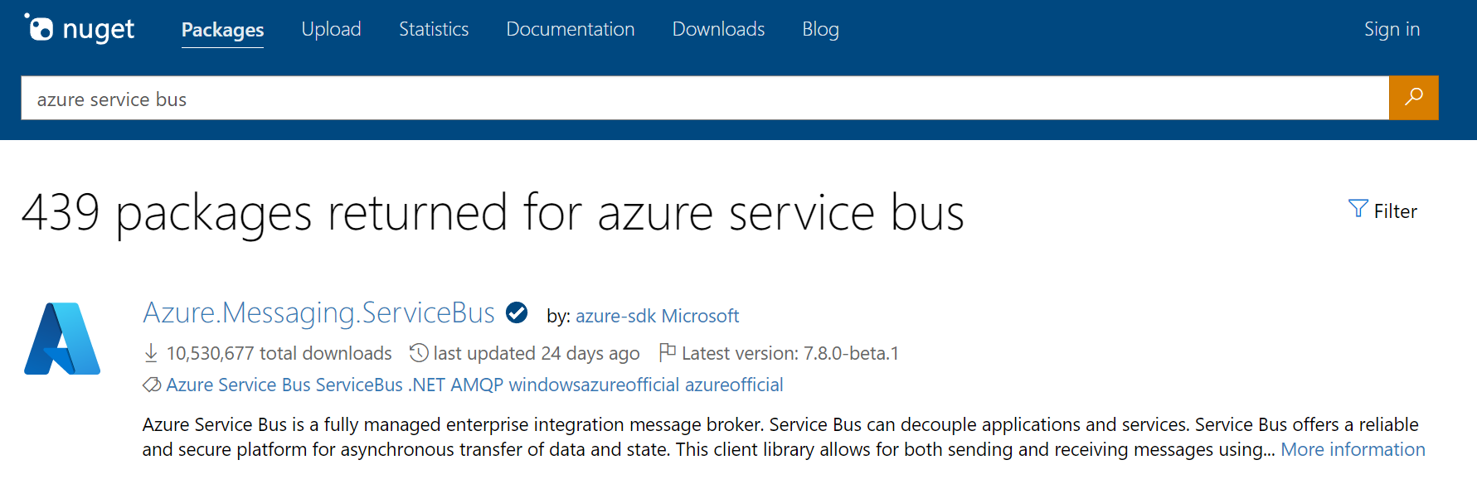
Notes:
Track 2 SDK (actually #3)

Slide 50
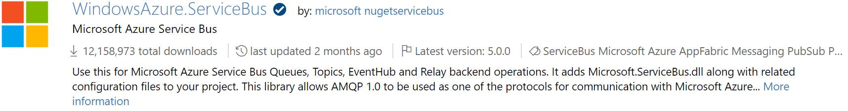
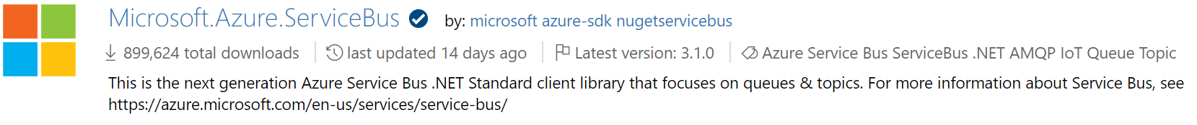
0
1

Slide 51

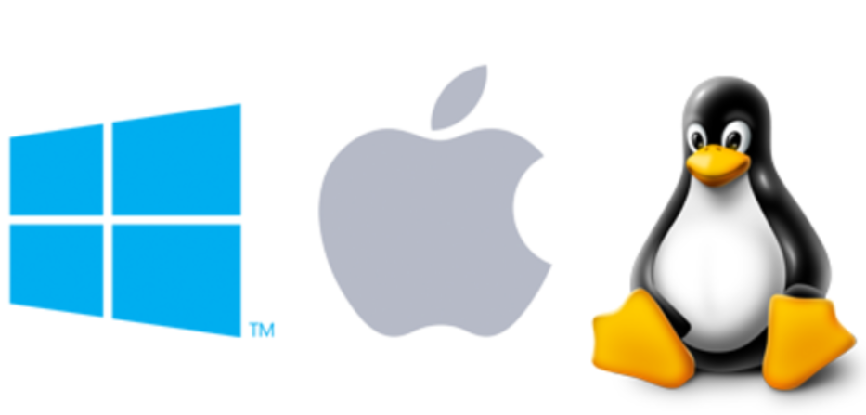

Slide 52

github.com/azure/azure-sdk-for-net
Notes:
A new mondo repo home

Slide 53
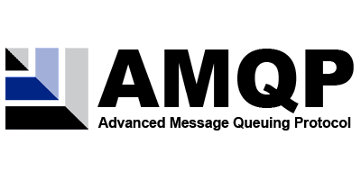
1.0
Notes:
AMQP + WebSockets
On the broker side, the new client is speaking AMQP 1.0 and no more SBMP protocol.
Meaning interoperability and less constraints (number of concurrent connections: 1K vs 5K)

Slide 54

Entity Management

Slide 55
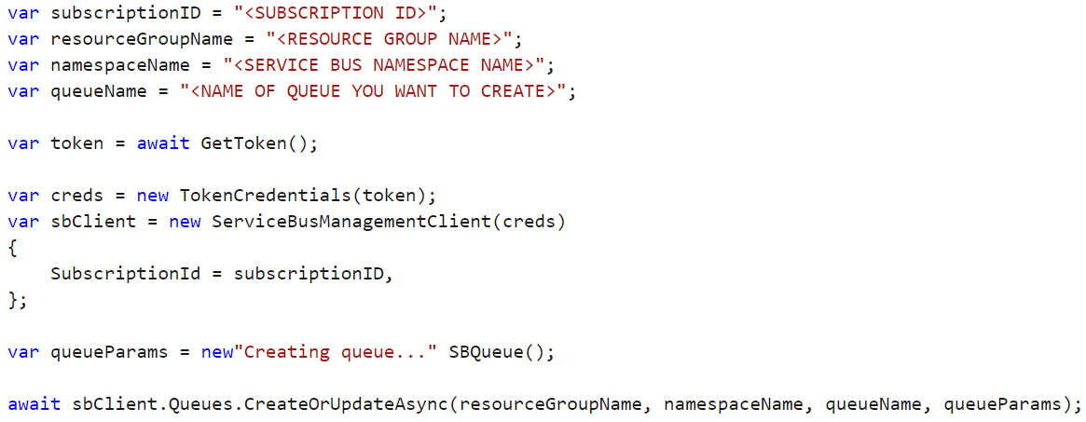
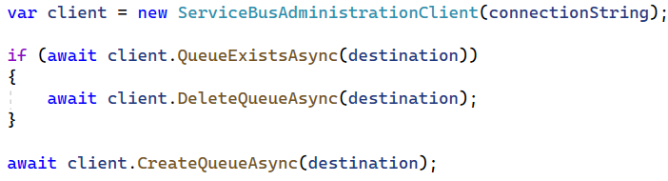
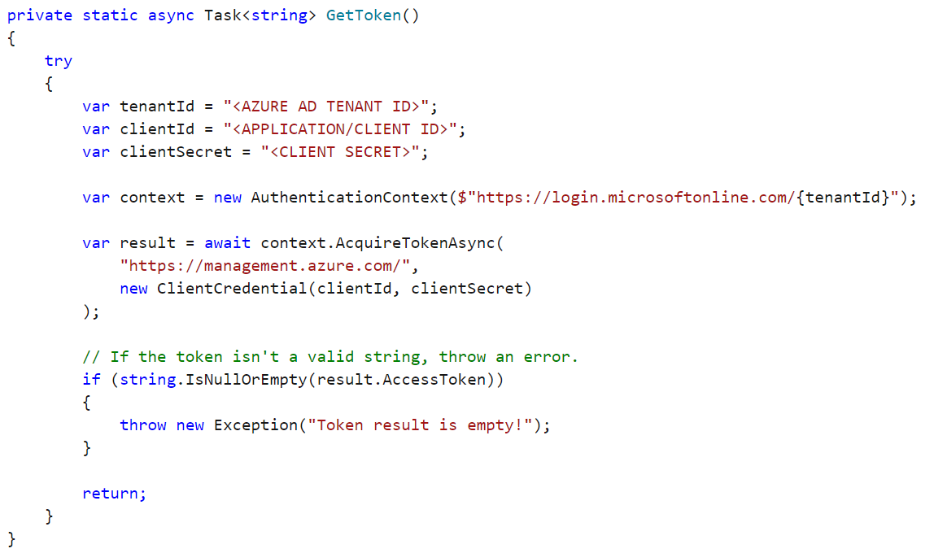
Management library
Microsoft.Azure.Management.ServiceBus
Client library
Azure.Messaging.ServiceBus

Slide 56
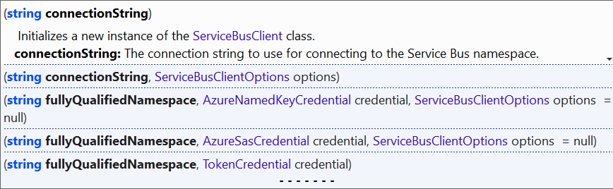
Connection Options

Slide 57

Sending Messages

Slide 58
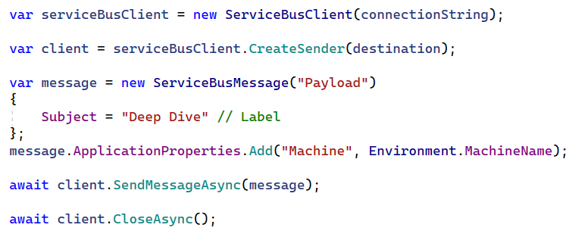
Code

Slide 59
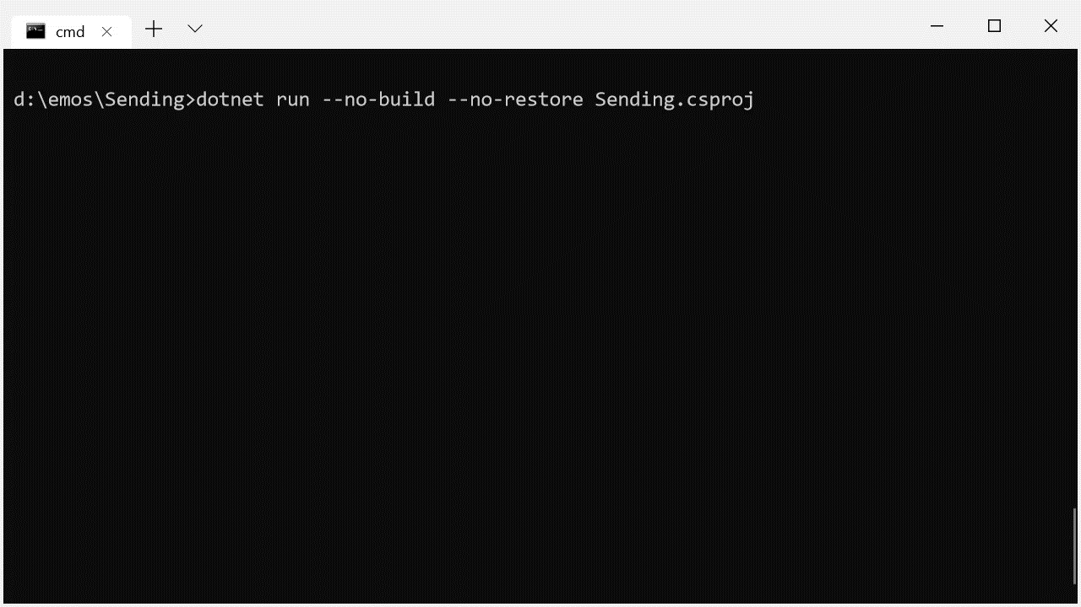

Slide 60
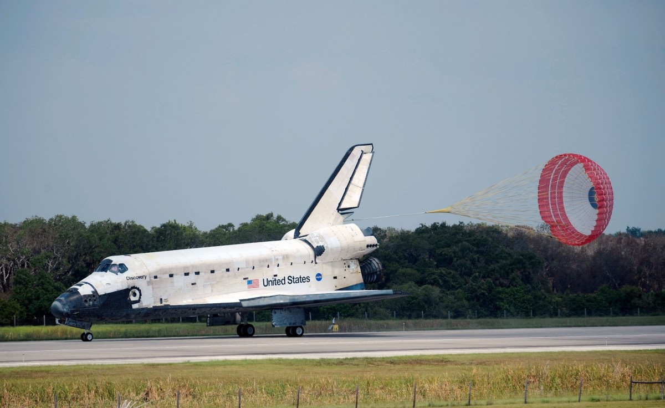
Receiving Messages

Slide 61
Receiving modes
ReceiveAndDelete
PeekLock
Notes:
Talk about PeekLock and ReceiveAndDelete

Slide 62
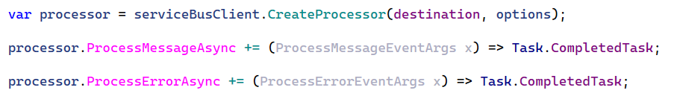
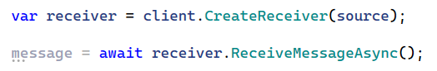
Simple Scenarios
ServiceBusProcessor
Advanced Scenarios
ServiceBusReceiver
Notes:
How do we receive? There are two options available
ServiceBusReceiver.ReceiveMessageAsync() requires to do manual heavy lifting such as concurrency etc. Also, hard to understand
Use message handlers instead
ServiceBusProcessorOptions
AutoCompleteMessages (defaults to true)
MaxConcurrentCalls (defaults to one)
MaxAutoLockRenewalDuration (defaults to 5mins)

Slide 63
Summery
Introduction
Architecture styles
Browse Azure Architectures

Slide 64
Thank You

